Slide 1
Overview of report of United Nations Network of Economic Statisticians to 55th Statistical Commission
Informal meeting of the United Nations Network of Economic Statisticians
6 November 2023
Benson Sim
United Nations Statistics Division

Slide 2

Outline of report
Introduction
Network members and bureau and workstreams
Achievements in 2023 and the Programme of Work for 2024
Global and regional consultations and Network meetings
Action to be taken by the Statistical Commission
Timeline

Slide 3

Network members and bureau and workstreams
Network members/bureau
Members 37 members from 27 Member States (including 18 Member States from the global South) 23 members from international and regional organizations, including the five UN regional commissions Co-chaired by Canada and the Maldives Bureau Two co-chairs Indonesia, the Netherlands, the UK, USA UNSD (secretariat)
Four workstreams
Networking (collaboration and user consultation) Transforming and challenging the system (statistical infrastructure and operations, and data solutions) Enabling (institutional arrangements and governance) Experimenting, integrating and documenting (statistical framework and methods)

Slide 4
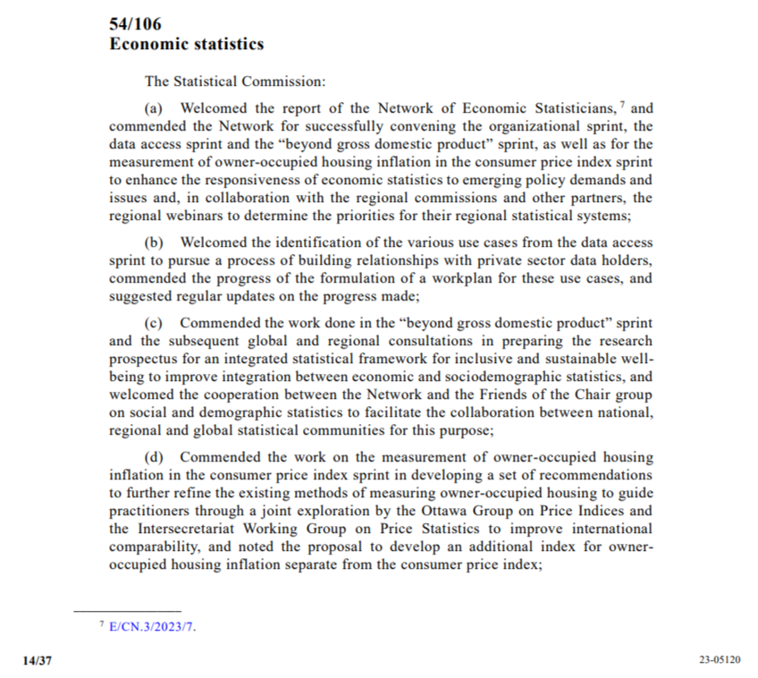
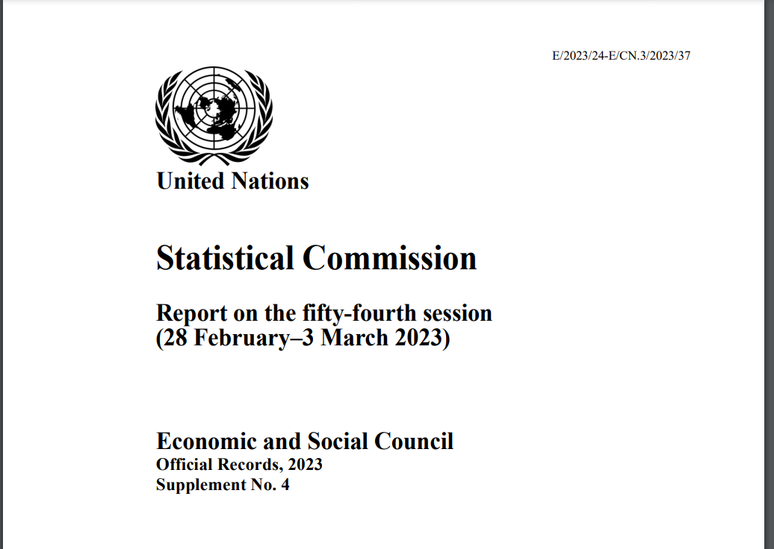
Introduction
Recalls decision 54/106 on report of Network to 54th session of Statistical Commission
Summarizes activities of the Network since the end of the 54th session of the Statistical Commission to November 2023 and proposed work programme for 2024

Slide 5

Achievements in 2023 - sprints
Beyond GDP sprint 2023 – completed
Led by UK ONS and organized in close collaboration with Friends of the chair group on social and demographic statistics Comprised 7 online meetings between June 2023 and October 2023 to explore the feasibility of a research agenda for a new integrated statistical framework for measuring inclusive and sustainable well-being in accordance with the research prospectus which was endorsed at 54th session of Statistical Commission Attracted well over 100 participants at each meeting, with over 200 participants at a couple of meetings, comprising Statisticians from diverse statistical domains (economic, social and demographic, environment statistics, etc. from national statistical offices, other government agencies and international and regional organizations Policy analysts Academia Background document including the proposal formation of a multi-disciplinary group to take forward the recommendations of the beyond GDP sprint 2023 will be prepared See here for links to all the meetings

Slide 6
Achievements in 2023 - sprints
International statistical classifications sprint - ongoing
Objectives Raise awareness of the importance of international classifications with both internal and external users Advance outreach by the Committee of Experts on International Statistical Classifications to engage NSOs Provide an additional forum for discussing and sharing modern ways of updating and implementing classifications Highlight the importance of investing in classification work as a foundation for data integration which addresses shared priority of data integration among statistical groups that the Network highlighted in synthesis note to 54th session of the Statistical Commission First hybrid webinar on 25 October 2023 attracted around 350 online participants Next online webinars (register here) 29 November 2023 31 January 2024 See here for more information

Slide 7
Achievements in 2023 - sprints
Data access sprint – post-sprint activities
Led by Statistics Netherlands in collaboration with Committee of Experts on Big Data and Data Science for Official Statistics Aimed to explore user needs, relevant data providers and relevant partnerships, which would help to gain greater insight into certain global value chains Completed in 2022 with five specific use cases for pursuing the process of building a relationship with private data holders Tourism industry use case, led by Maldives Semiconductor industry use case, led by the Netherlands E-commerce use case, led by the United Kingdom Retail industries use case, led by the United Arab Emirates Horticultural industry use case, led by Colombia Process of developing workplans has started; so have conversations with private data providers

Slide 8

Achievements in 2023 – consultations and meetings
Global and regional consultations
Meeting with ESCAP, ECA, ESCWA and ECLAC in July 2023 to determine statistical priorities of global South Presentation on progress of beyond GDP sprint 2023 at ECLAC seminar in October 2023 Presentation on overview of Network activities at ESCAP’s Joint Meeting of the Steering Group for the Regional Programme for the Improvement of Economic Statistics in Asia and the Pacific and the Regional Steering Group on Population and Social Statistics in November 2023 Meetings of Friends of the Chair group on social and demographic statistics to discuss how to enhance integration economic and sociodemographic statistics
Network meetings
Two Network meetings were organized in June and September 2023 Innovations to increase interaction and engagement include Keynote presentations Live poll on priorities of global South in September 2023 meeting One more meeting is scheduled for December 2023 One informal meeting was organized in November 2023 Network bureau organized fortnightly meetings in 2023 to discuss progress of work programme

Slide 9

Programme of work in 2024
2024 work programme
Take forward recommendations of Beyond GDP sprint 2023, including formation of multi-disciplinary group to take forward the recommendations Continue post-sprint activities of data access sprint Continue global and regional consultations Continue Network and informal meetings, including possible side event at 55th session of Statistical Commission, and Network bureau meetings

Slide 10

Action to be taken by the Statistical Commission
To express its views on the progress made by the Network and its sprints;
Endorse the work program of the Network for 2024 covering the following:
Follow-up work including the proposal formation of a multi-disciplinary group to take forward the recommendations of the beyond GDP sprint 2023;
Follow up work on the priorities for the modernization of national statistical agencies in the Global South arising from a discussion with the regional commissions;
Continuation of the regional and global consultations on shared statistical priorities and collaborative arrangements and Network and informal meetings

Slide 11

Timeline
Report to be submitted by 29 November 2023 for editing and translation into non-English UN languages
Background document to be posted on Commission’s website by mid-January 2024

Slide 12


Thank you for your attention
nes@un.org
Visit https://unstats.un.org/unsd/statcom/groups/NetEconStat/
for updates

